Slide 1
COCOA 2015
The 9th Annual International Conference on Combinatorial Optimization and Applications

Slide 2
Location
COCOA 2015 will be held in Houston, Texas nearby the Galleria shopping mall.

Slide 3
topics of interest
Algorithms and Data Structures
Approximation Algorithms
Bioinformatics
Communication Networks
Computational Algebra
Computational Biology
Computational Financing
Computational Game Theory
Computational Geometry
Computational Learning Theory
Computational Number Theory
Extremal Graph Theory
Graph Searching
Graph Theory
Network Flow
Network Optimization Problems
Operation Research
Optimal Resource Management
Parallel and Distributed Computing
Scheduling

Slide 4
Publication
The conference proceedings will be published by
Lecture Notes in Computer Science (LNCS)
After the conference, some selected papers will be published in special issues of
Theoretical Computer Science
Journal of Combinatorial Optimization
Computational Social Networks
Algorithmica
Notes:
Elsevier journal covering the mathematical and theoretical basis of computer science.
This journal advances and promotes the theory and applications of combinatorial optimization.
Algorithmica is an international journal which publishes theoretical papers on algorithms that address problems arising in practical areas.
Computational Social Networks showcases refereed papers dealing with all mathematical, computational and applied aspects of social computing

Slide 5
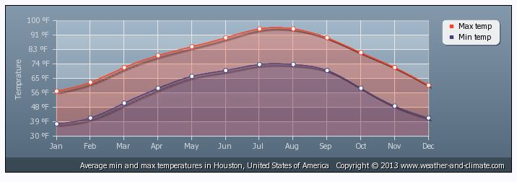
Climate Houston
In December
Temperature:
Max 60
Min 40
Precipitation:
About 2 inch

Slide 6
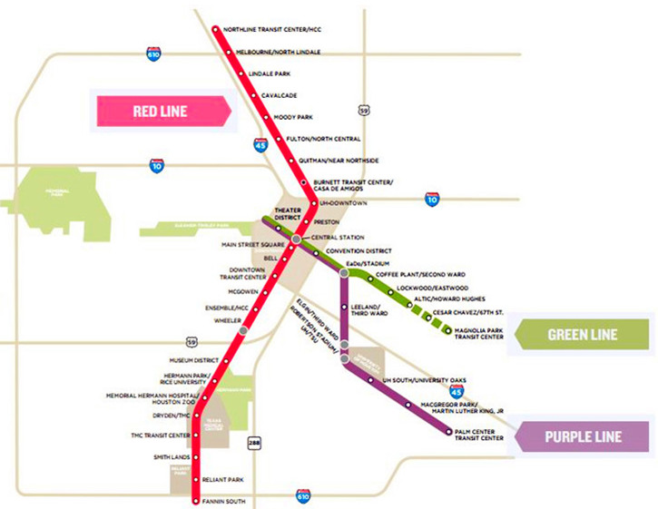
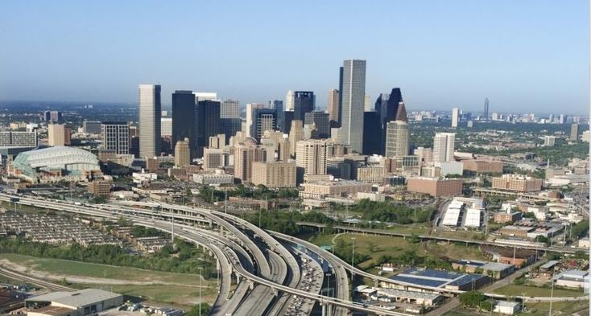
Transportation
METRO Rail is a fast, convenient way to travel to downtown, midtown, the Museum District.
Rent Cars in GEORGE BUSH AIRPORT and HOBBY AIRPORT
Notes:
METRORail is a fast, convenient way to travel to downtown, midtown, the Museum District, Medical Center, Moody Park.
The Red Line, (formerly the Main Street Line) It covers downtown, Midtown, the Museum District.

Slide 7
Have Fun
Top 3 Attractions in Houston

Slide 8
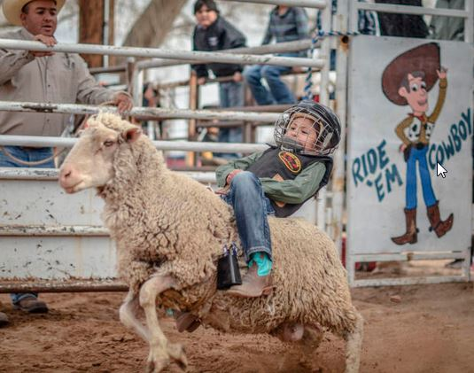
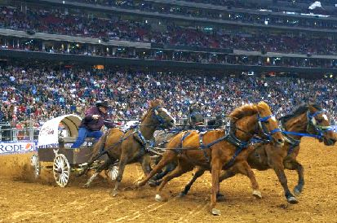
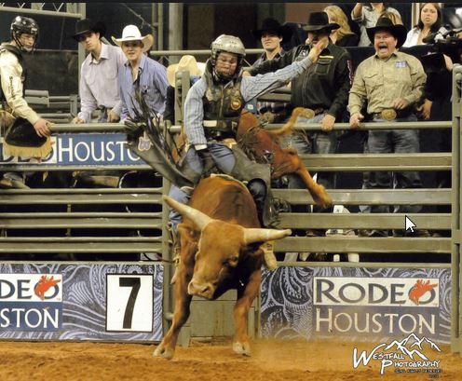
Houston Rodeo
The Houston Livestock Show and Rodeo, also called Rodeo Houston is the world's largest live entertainment and livestock exhibition
Notes:
The Houston Livestock Show and Rodeo, also called RodeoHouston or abbreviated HLSR, is the world's largest live entertainment and livestock exhibition.^{[citation needed]} It also includes one of the richest regular-season rodeo events. It has been held at NRG Stadium in Houston, Texas, since 2003. It was previously held in the Astrodome.^{[2]} It is considered to be the city's "signature event", much like New Orleans's Mardi Gras, Dallas's Texas State Fair, and New York City's New Year's Eve at Times Square.^{[3]}
In 2013, attendance reached a record high of 2,506,238 people^{[4]} requiring more than 28,000 volunteers. In 2007, the rodeo was deemed "the year of the volunteer."^{[5]} The event is 20 days long. It is kicked off by the Downtown Rodeo Roundup held near Houston City Hall, the Downtown Rodeo parade, and the ConocoPhillips Rodeo Run - a 10k and 5k walk & run and the World's Championship Bar-B-Que Contest.^{[6]} The show features championship rodeo action, livestock competitions, concerts, a carnival, pig racing, barbecue and the Rodeo Uncorked! International Wine Competition, shopping, sales and livestock auctions. Traditional trail rides, which start in different areas of Texas and end in Houston, precede the Rodeo events.^{[7]} The City of Houston celebrates this event with Go Texan Day, where residents are encouraged to dress in western wear the Friday before the rodeo begins.^{[8]}
The rodeo has drawn some of the world's biggest recording artists, including Kiss, Elvis Presley, Bob Dylan, Brooks & Dunn, George Strait, Garth Brooks, Willie Nelson, Selena, Bon Jovi, ZZ Top, Taylor Swift and Lynyrd Skynyrd, among others.

Slide 9
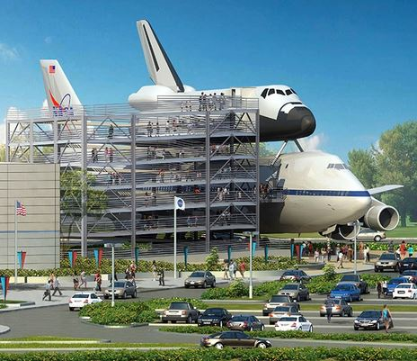
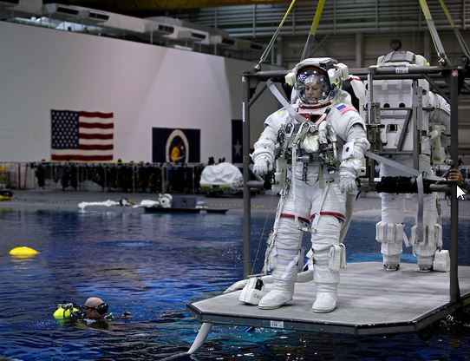
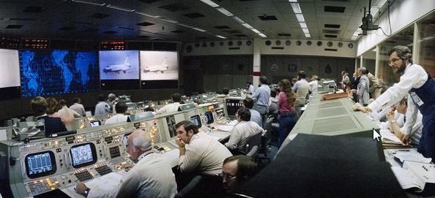
Space Center
It is the Home for NASA and also center for human spaceflight activities.
Notes:
The pride of Houston -- NASA. It's what made us the Astro-city. These days missions have been grounded, but the historic artifacts of the country's extra-terrestrial adventures and tragedies are preserved at the Space Center Houston. Don't get the idea that Space Center Houston is a museum -- yes, it houses lots of NASA's historical artifacts, but it features a robust schedule of exhibits (Star Wars-related exhibits are a favorite, for obvious reasons) and 'interactive adventures' (translation: on-hands exhibits packed with bells and whistles for kids).
Our favorite Space Center Houston event? The regular Lunch with an Astronaut offerings. A genuine, real life astronaut with plenty of amazing stories to tell sits at every table with a small group of visitors. Very, very cool.

Slide 10
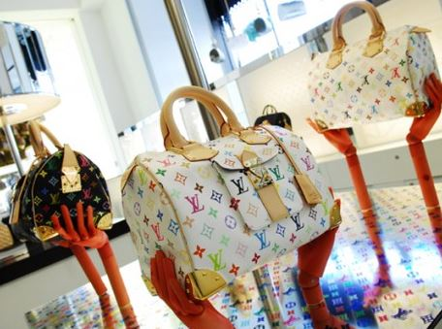
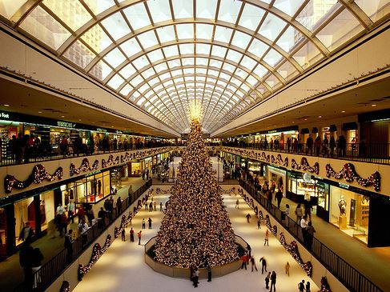
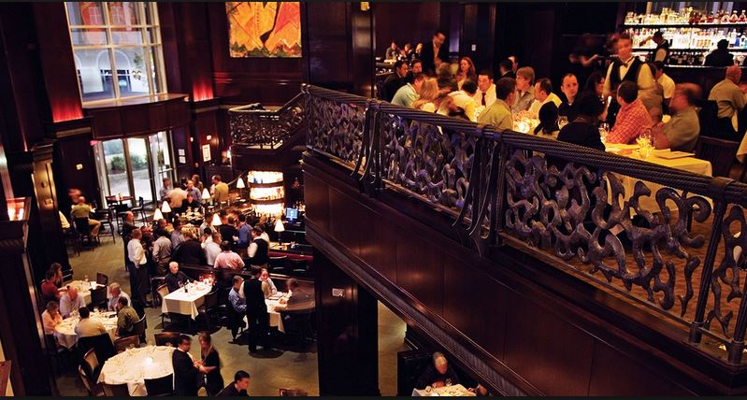
The Galleria
The Galleria , Texas’ largest shopping center and fourth largest domain nationally.
For shopping, opportunities are endless at anchoring stores such as: Tiffany & Co., Yves Saint Laurent, Ralph Lauren, Fendi, Gucci, Louis Vuitton, Valentino, Chanel, Prada, Miu Miu and Cartier.
Notes:
Mega-malls have become commonplace, but the Galleria continues to stand out because of its classy veneer. The mall has some 400 shops, including Gucci, Apple and Tiffany & Co., spread out over several levels, making window shopping a day-long adventure. Take a break at any of the dozens of restaurants or watch the newbies try to navigate the ice skating rink. Expect every holiday to be commercialized to the max (Christmas and Valentine's Day here are way over the top) and everything you see to have a price tag. (Bonus points for its excellent air conditioning system; strolling through its cool corridors is a welcomed respite from the Houston heat often waiting just outside the door.)

Slide 11
Other Attractions
Houston Zoo
Museum of Fine Arts
Museum of Natural Science
Houston Astros (MLB)
Houston Texans (NFL)
Houston Rockets (NBA)
Notes:
Houston Museum District officials like to boast that visitors can go around the world without ever leaving the zip code. True, we've seen amazing exhibits of art by European masters, heard concerts by Middle-eastern superstars, and petted animals that usually call the polar regions home all in one day.
A visit to the Museum District requires some planning, unless you don't mind circling the neighborhood for a parking area and are okay sharing lunch with 300 elementary school children. The offerings here are world-class, and a little planning can make your visit go smoother. Even if you don't go into any of the museums -- and we enthusiastically recommend that you do -- you can enjoy the district's great architecture and lovely green spaces.

Slide 12
Your Contributions are very Welcome
Important Dates:
Submission Due: July 15th (by 11:59:59 PM, CEST)
Notification of Acceptance: August 15th
Final Version Due: September 1st
Conference Dates: December 18-20
Contact: Please send all concerns and questions to the email address
cocoa15.chairs@gmail.com

