Slide 1
How to Schedule a Cascade in an Arbitrary Graph
F. Chierchetti, J. Kleinberg, A. Panconesi
February 2012
Presented by Emrah Cem
7301 – Advances in Social Networks
The University of Texas at Dallas, Spring 2013

Slide 2
Categories
Influence Maximization
Community Detection
Link Prediction

Slide 3
People get influenced by other’s (their acquaintances’) decisions towards buying a product.
Amongst two competing products, both placed equally initially, one manages to capture market significantly faster than the other.
These cascades are result of certain early decisions made by a group of consumers. Has been studied in Economics.
Design of such initial adopters to seed a desired cascade (by medium of a social network) – the basic aim of this paper.
Two assumptions –
Only two competing products (only two choices).
Primary model – Sequential decisions with positive externalities.

Slide 4
Sequential decisions with positive externalities (Arthur, ‘89)
Two types of products – Y’ and N’.
Population divided into two classes – Y-types and N-types.
A Y-type gets a payoff of P1 from Y’ and P0 from N’. Given P1 > P0.
Due to positive externality, a payoff of D per user is added to the total payoff.
Say, current number of users of Y’ be M_{y} and that of N’ be M_{n}.
Therefore, for one Y-type -
Total Payoff (from Y’) = P1 + D*M_{y}
Total Payoff (from N’) = P0 + D*M_{n}
The larger payoff option wins.
Analogous rules for a N-type person.

Slide 5
Decision Parameter c = |P1 – P0|/D
Therefore, when
|M_{y} – M_{n}| >= c A person will follow the majority
|M_{y} – M_{n}| < c A person will follow his own choice
For the given model, let’s say:
My = Mn = 0, initially.
Each new Y-type arrives with a probability p > 0
Each new N-type arrives with a probability (1 - p) > 0
Therefore, the first of the either types to have ‘c’ more users will be locked-in, and all decisions made hence will be in favor of the this type.
Probability –product of that happening for Y-type =

Slide 6
The Problem:
Input: Graph ‘G’; Decision parameter ‘c’; Probability (p) for Y-type and (1-p) for N-type.
The type of nodes are revealed when they get to decide their choice.
The basic model is that of Arthur’s (as described previously). The only exception is that, now, M_{y} for a node would be the number of neighbors of that node in the graph with a Y’ decision, and vice-versa for M_{n}.
The idea of constant adoption:

Slide 7
The Results:
The paper states that all graphs can be made to exhibit a constant adoption with expected number of Y’s at least
Methodology:
Within the given graph, a maximal set of nodes is identified in which all nodes make decisions independently.
Subsequently, other nodes are added to S with the intent that a decision from S would be forced on the incoming nodes.

Slide 8
Notes:
The paper mentions that there can be graphs for which the expected number of Y’s can be (n – O(1/p)), and this is the maximum possible for any given graph.
The model used is an adaptive one, in which while scheduling a node one gets to see the type and decisions of all previously decided nodes.
Another version is the non-adaptive one in which an ordering of the full set is created first before seeing the types and decisions of any node.

Slide 9
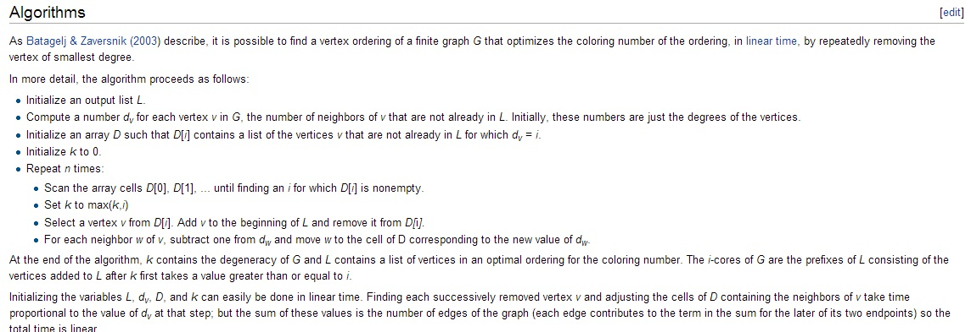
Concepts used in the algorithm:
Although not mentioned in the paper, a possible way to do this would be (from: Wikipedia):

Slide 10
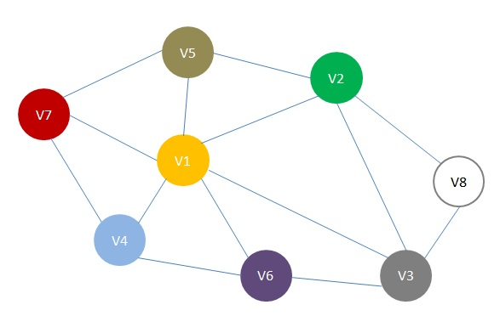
V5
c = 3,
W = 2-degenerate sub-graph with Erdos-Hajnal sequence
V2
V7
V8
V4
V6
Graph G
Generation of W
W = {V8, V5, V7, V4, V6, V2}
V(G) - W = {V1, V3}

Slide 11
c = 3,
W = 2-degenerate sub-graph with Erdos-Hajnal sequence
V1
V2
V1
V2
V3
V3
V4
V5
V5
Graph G

Slide 12
The Algorithm:

Slide 13
c = 3,
W = 2-degenerate sub-graph with Erdos-Hajnal sequence
Y’
V5
Y’
V2
Y’
V7
V1
N’
V8
Y’
(forced)
V4
Y’
V6
V3
N’
N’
W = {V8, V5, V7, V4, V6, V2}
V(G) - W = {V1, V3}

Slide 14
Lower bound on E[# of Y decisions]
Under the given model
Y-type user
With the scheduling produced by Algo. 1
Complete graphs
Empty graphs (no edges)
Any graph !!!

Slide 15
decision parameter
Proof: W is maximal (c-1) degenerate set, so every node in v Є V(G) –W will be connected to at least c nodes in W, otherwise we could add v to W while still keeping W ᴜ {v} has a (c-1)-degenerate graph, and so W would not be maximal.
Let k = k(v) be the smallest integer such that v has at least c neighbors in the prefix v₁,v₂,…,v_{k}. After having scheduled v_{k} , node v will have exactly c activated neighbors in W.

Slide 16
Example with c=3
2
v5
v2
1
Nodes in W
Nodes in V(G) - W
v1
v6
v1,v2,v3,v4,v5,v6 is a Erdӧs –Hajnal sequence of nodes in W which is maximal 2-degenerate.
v4
2
1
v3
2

Slide 17
Proof: If a new node is activated at line 5, c of the neighbors in W have been activated and all of them have chosen , and all its activated neighbors (if any) in V(G)-W have chosen . Therefore v will choose . On the other hand, if at least one of the activated nodes in W chose , then v will not be scheduled until line 7 is reached.

Slide 18
Example with c=3
Unactivated until Line 7
v5
v2
Nodes in W
Nodes in V(G) - W
v1
v6
v4
v
v3

Slide 19
Proof: Before reaching line 7, all activated nodes in V(G) – W will choose (actually will be forced !!). Thanks to our choice of ordering of nodes in W, when we activate a node v in W, there will be at most (c-1) neighbors in W that have already been activated. Therefore, either v will be forced to choose , or its choice will be equal to its type.

Slide 20
Example with c=3
Will be forced to choose
v5
v2
Nodes in W
Nodes in V(G) - W
v1
v6
v4
v
v3
Will be forced to choose

Slide 21
Proof: At iteration k(v), when v has exactly c active neighbors w₁, w₂,… , w_{c} in W. we execute v iff each of w_{i}’s chose . Since w_{i}’s signal is independent of other signals, we have that w₁, w₂,… , w_{c} all choose , therefore v will choose , with probability at least p^{c}.

Slide 22
Example with c=3
v5
v2
Nodes in W
Nodes in V(G) - W
v1
v6
P( will choose ) =
P( at step k(v) all neighbors in W have chosen )
+ P( will choose at line 7)
v
v4
v3
v
≥ 0
By Lemma 2.4, each node in W choose with probability at least p, so the probability that all of them will choose , therefore v will be forced to choose , is at least p^{c} .

Slide 23
Since every node v of G is either part of W or V(G) – W, we have that expected value of the random variable indicating the choice of is at least p^{c} due to the linearity of expectation.
Every node in W will choose with probability at least p.
Every node in V(G) – W will choose with probability at least p^{c}.

Slide 24
Conclusion
A formal influence model was explained.
Algorithm was explained.
It has been proven that for any graph, proposed algorithm guarantees that E[X]≥p^{c} n, where X is the # of nodes having chosen Y.

Slide 25
p≥p^{c} (since 0≤p≤1, and c≥1), so the larger the size of the (c-1)-degenerate induced subgraph, the larger the expected number of ‘s.
Question : Is the size of the (c-1)-degenerate graph limited?
Yes.
Since c is constant, it is always possible to get a scheduling of value
Size of the maximum independent set

Slide 26
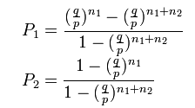
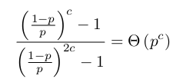
Unfair coin flipping (unfair gambler’s ruin)
Player one has n1 coins, player 2 has n2 coins. When one wins a toss, it takes one penny from the other
Player one wins each toss with prob. p , player two wins with prob. q=1-p, then probability of each ending penniless:
In our case n1=n2=c , and q=1-p so probability that P₁ wins the game is

Slide 27
Maximum number of a’s
We have seen that on any graph of size n, one can find a scheduling guaranteeing at least p^{c}n y’s on expectation.
Question: What is the largest possible number of y’s on expectation?

Slide 28
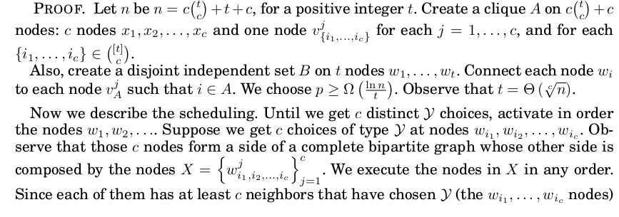

Slide 29
Construction example (t=3, c=2)
nodes
v1{1,2}
c=2 nodes
v1{1,3}
t=3 nodes
x1
v1{2,3}
w1
w2
x2
v2{1,2}
w3
v2{2,3}
v2{1,3}

Slide 30
Scheduling for the constructed graph
Until we get c choices,schedule in order the nodes w1, w2,…
v1{1,2}
t=3, c=2
v1{1,3}
x1
v1{2,3}
w1
wi1
w2
x2
v2{1,2}
w3
wi2
v2{2,3}
v2{1,3}

Slide 31
There should exist c vj{i1,i2,…,ic} nodes such that when red edges are considered only, there is a complete bipartite graph where wi1, wi2,…, wic are on one side and c vj{i1,i2,…,ic} nodes on the other side. Schedule these c vj{i1,i2,…,ic} nodes.
v1{1,2}
t=3, c=2
forced
v1{1,3}
x1
v1{2,3}
w1
wi1
w2
x2
v2{1,2}
w3
wi2
v2{2,3}
forced
v2{1,3}

Slide 32
Schedule the nodes x1, x2, …,xc in any order. Since they have exactly c activated neighbors where all have been forced to choose , therefore nodes x1, x2, …,xc will also be forced to choose .
v1{1,2}
t=3, c=2
forced
v1{1,3}
forced
x1
v1{2,3}
w1
wi1
w2
forced
x2
v2{1,2}
w3
wi2
v2{2,3}
forced
v2{1,3}

Slide 33
Schedule the remainder of the clique. All remaining nodes in clique has at least 2c neighbors that have chosen and and at most c neighbors that have chosen , all of tem will be forced to choose .
forced
v1{1,2}
t=3, c=2
forced
v1{1,3}
forced
x1
forced
v1{2,3}
w1
wi1
w2
forced
x2
forced
v2{1,2}
w3
wi2
forced
v2{2,3}
forced
v2{1,3}

Slide 34
Schedule the every remaining wi node. All remaining wi nodes are connected to exactly c activated nodes that have chosen . Therefore, all will be forced to choose .
forced
v1{1,2}
t=3, c=2
forced
v1{1,3}
forced
x1
forced
v1{2,3}
w1
wi1
w2
forced
x2
forced
v2{1,2}
w3
wi2
forced
v2{2,3}
forced
v2{1,3}

Slide 35
Upper bound on max number of y’s
Note that once we get at least c different y’s, every remaining node will choose .
Each w_{i} node activated before we get the (c+1)st choice of , is activated independently from the others. So expected number of n’s are a most
Therefore, expected number of y’s are at most .

Slide 37
Non-adaptive version
First fix the schedule, then activate the nodes.

