Slide 1
A Survey on Clustering Schemes
Jane Y. Yu and Peter H.J. Chong, “A Survey of Clustering Schemes For Mobile Ad Hoc Networks” IEEE Communications, Surveys, First quarter 2005, Vol. 7 No. 1.
Presented By Donghyun Kim September 5, 2008 Mobile Computing and Wireless Networking Research Group
at University of Texas at Dallas

Slide 2
Introduction
MANETs (Mobile Ad-hoc Networks)
Allow mobile terminals to set up a temporary network for instant communication without fixed infrastructures.
A flat structure exclusively based on proactive or reactive routing schemes cannot perform well in a large dynamic MANET – Scalability Issue.
Presented by Donghyun Kim on September 5, 2008 Mobile Computing and Wireless Networking Research Group at The University of Texas at Dallas

Slide 3
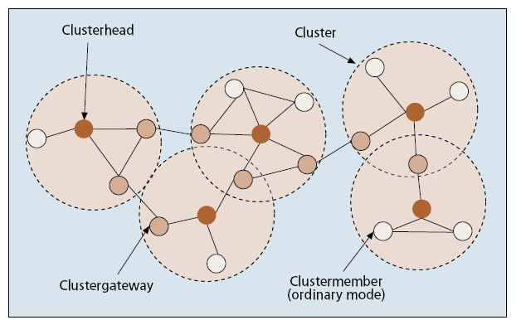
Introduction – cont’
Clustering?
A clustering in networks is that the nodes in the network is partitioned into virtual groups by predefined rules.
Nodes are divided into three groups - clusterhead, clustergateway, or clustermember
Presented by Donghyun Kim on September 5, 2008 Mobile Computing and Wireless Networking Research Group at The University of Texas at Dallas

Slide 4
Introduction – cont’
Roles
Clusterhead
Normally serves as a local coordinator for its cluster, performing intra-cluster transmission arrangement, data forwarding, and so on.
Clustergateway
Non-clusterhead node with inter-cluster links, so it can access neighboring clusters and forward information between clusters.
Clustermember - Else
Presented by Donghyun Kim on September 5, 2008 Mobile Computing and Wireless Networking Research Group at The University of Texas at Dallas

Slide 5
Benefits of Clustering
A cluster structure, as an effective topology control means, there are at least three benefits.
Facilitates the spatial reuse of resources to increase the system capacity, resulting in reducing collision, etc.
Decrease routing overhead since less number of nodes will be involved in routing.
Helps an ad hoc network more smaller and stable in the view of each mobile terminal.
Presented by Donghyun Kim on September 5, 2008 Mobile Computing and Wireless Networking Research Group at The University of Texas at Dallas

Slide 6
Cost of Clustering
Constructing and maintaining a cluster structure usually requires additional cost compared with a flat-based MANET.
In a dynamically changing scenario, clustering-related information exchange increases drastically.
Ripple effect - some clustering schemes may cause the cluster structure to be completely rebuilt over the whole network when some local events take place.
Frozen period - most schemes separate the clustering into two phases, cluster formation and maintenance, and assume mobile nodes keep static when cluster formation is in progress – may not applicable in real scenario.
Timing issues - Since all nodes are not synchronized, cluster formation takes a long time.
Presented by Donghyun Kim on September 5, 2008 Mobile Computing and Wireless Networking Research Group at The University of Texas at Dallas

Slide 7
Classification of Clustering Schemes
Clusterhead-based vs. Non-clusterhead-based
1-hop clustering vs. Multi-hops clustering
Based on objectives
DS (Dominating Set)-based clustering
Low-maintenance clustering
Mobility-aware clustering
Energy-efficient clustering
Load-balancing clustering
Combined-metrics-based clustering
Presented by Donghyun Kim on September 5, 2008 Mobile Computing and Wireless Networking Research Group at The University of Texas at Dallas

Slide 8
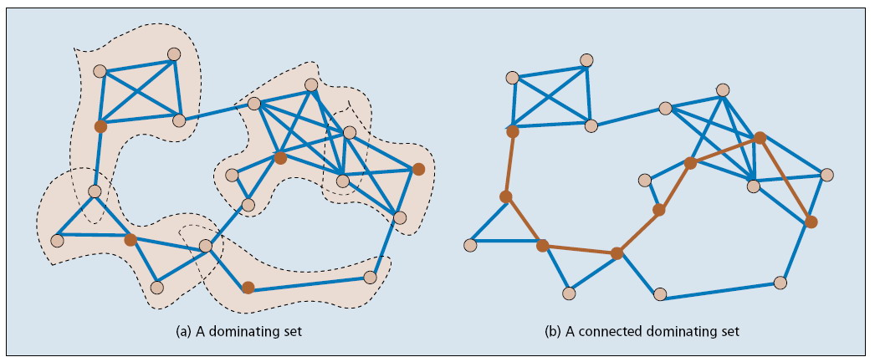
DS-based Clustering
Goal
Finding a connected dominating set to reduce the number of nodes participating in rout search or routing table maintenance.
Presented by Donghyun Kim on September 5, 2008 Mobile Computing and Wireless Networking Research Group at The University of Texas at Dallas

Slide 9
Low-maintenance clustering
Goal
Providing a cluster infrastructure for upper layer applications with minimized clustering-related maintenance cost (i.e. messages).
Limiting re-affiliation and re-clustering events.
Summary
LLC (Least Cluster Change)
LIC (Lowest ID Clustering) - a node with highest ID becomes a cluster head.
HCC (Highest Connectivity Clustering) - a node with highest local node degree becomes a cluster head.
LCC – use LIC for the initial construction. When two clusters meet, one head retires. Nodes without an adjacent a head use LIC to build a new cluster.
3hBAC (3-hop Between Adjacent Clusterheads)
Forms a 1-hop non-overlapping cluster structure with three hops between neighboring clusterheads by introducing a new node status, named clusterguest (which is not adjacent to a head directly).
Lin’s Algorithm
An adaptive clustering scheme to form a non-overlapping cluster architecture without clusterheads because clusterheads bear extra work compared with ordinary member nodes and likely will become the bottlenecks of a network.
PC (Passive Clustering)
A node without an adjacent head piggybacks its claim with normal message.
Each node is responsible for updating its own cluster status by keeping a timer.
Presented by Donghyun Kim on September 5, 2008 Mobile Computing and Wireless Networking Research Group at The University of Texas at Dallas

Slide 10
Mobility-aware clustering
Goal
Utilizing mobile nodes’ mobility behavior for cluster construction and maintenance and assigning mobile nodes with low relative speed to the same cluster to tighten the connection in such a cluster.
By grouping mobile terminals with similar speed into the same cluster, the intra-cluster links can become more tightly connected.
Summary
MOBIC
Suggests that cluster formation, especially clusterhead election, should take mobility into consideration.
Calculate the aggregate local speed and choose the one with the lowest mobility.
DDCA (Distributed Dynamic Clustering Algorithm)
Find a set of node such that a communication graph induced by them can be a complete graph with some probability for some duration.
Presented by Donghyun Kim on September 5, 2008 Mobile Computing and Wireless Networking Research Group at The University of Texas at Dallas

Slide 11
Energy-efficient clustering
Goal
Avoiding unnecessary energy consumption or balancing energy consumption for mobile nodes in order to prolong the lifetime of mobile terminals and a network.
Summary
IDLBC (ID Load Balancing Clustering)
A mobile node with the higher VID becomes a cluster head. VID is proportional to 1/(current energy level).
Wu’s Algorithm
DS-based Clustering
A head retires if all of its members can be covered by other heads
Ryu’s Algorithm
Heads are pre-selected and can have a limited number of members.
Assume transmission power is adjustable.
Presented by Donghyun Kim on September 5, 2008 Mobile Computing and Wireless Networking Research Group at The University of Texas at Dallas

Slide 12
Load-balancing clustering
Goal
Distributing the workload of a network more evenly into clusters by limiting the number of mobile nodes in each cluster in a defined range.
Summary
AMC (Adaptive Multi-hop Clustering)
BLBC (Degree-Load-Balancing Clustering)
Initial cluster structure is given
By exchanging messages, each cluster adjusts its size
Differ in detail
Presented by Donghyun Kim on September 5, 2008 Mobile Computing and Wireless Networking Research Group at The University of Texas at Dallas

Slide 13
Combined-metrics-based clustering
Goal
Considering multiple metrics in cluster configuration, including node degree, mobility, battery energy, cluster size, etc., and adjusting their weighting factors for different application scenarios.
Summary
On-Demand WCA (Weighted Clustering Algorithm)
Followings are considered for electing a cluster head
Degree-difference
Sum of the distance with all neighbors
Average moving speed
Clusterhead serving time
Presented by Donghyun Kim on September 5, 2008 Mobile Computing and Wireless Networking Research Group at The University of Texas at Dallas

