Slide 1
Underwater Acoustic Sensor Networks: New Challenges
F. Akyildiz, D. Pompili, and T. Melodia, "Underwater acoustic sensor networks: Research challenges," Journal of Ad Hoc Network, vol. 3, no. 3, pp. 257-279, Mar. 2005.
Presented By Donghyun Kim September 12, 2008 Mobile Computing and Wireless Networking Research Group
at University of Texas at Dallas

Slide 2
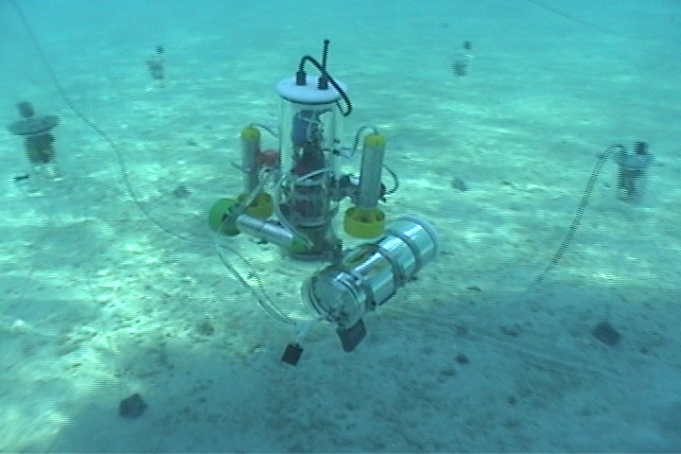
Underwater Sensor Networks?
AMOUR (Autonomous Modular Optical Underwater Robot)
(Image Source: http://groups.csail.mit.edu/drl/wiki/images/d/db/amour_with_sensors.jpg)
Presented by Donghyun Kim on September 12, 2008 Mobile Computing and Wireless Networking Research Group at The University of Texas at Dallas

Slide 3
Motivation
Traditional approach for underwater monitoring
Deploy underwater sensors that record data during the monitoring mission
Recover the instruments
Drawbacks
No real-time monitoring
No on-line system reconfiguration
No failure detection
Limited storage capacity
Presented by Donghyun Kim on September 12, 2008 Mobile Computing and Wireless Networking Research Group at The University of Texas at Dallas

Slide 4
Applications
Ocean sampling networks
Environmental monitoring
Undersea explorations
Disaster prevention
Realtime constraint
Assisted navigation
Distributed tactical surveillance
The location of sensors/observers have to be remained secure
Mine reconnaissance
Presented by Donghyun Kim on September 12, 2008 Mobile Computing and Wireless Networking Research Group at The University of Texas at Dallas

Slide 5
History of Underwater Communication
During WWII (in 1945), an underwater telephone was developed to communicate with submarines.
Three types of wireless link
Radio Frequency (RF) signal
Only radio signal with extra low frequency (30-300Hz) can travel in sea water – Requires large antennae and high transmission power
Optical link
Optical waves are significantly affected by scattering
Acoustic link
Practical solution
Acoustic communications are the typical physical layer technology in underwater networks
Presented by Donghyun Kim on September 12, 2008 Mobile Computing and Wireless Networking Research Group at The University of Texas at Dallas

Slide 6
Challenges
Bandwidth is severely limited
Underwater channel is severely impaired
Due to multi-path and fading.
Long and variable Propagation delay
High bit error rates and temporary losses of connectivity
Battery power is limited
Usually batteries cannot be recharged since solar energy cannot be exploited
Underwater sensors are prone to failures because of fouling and corrosion
Presented by Donghyun Kim on September 12, 2008 Mobile Computing and Wireless Networking Research Group at The University of Texas at Dallas

Slide 7
Design Issues
Design Issue - underwater sensor networks are expensive
Has to be highly reliable
Have to avoid a failure by a single point
No bottleneck
Three architectures
Static two-dimensional UW-ASNs for ocean bottom monitoring
Environmental monitoring
Static three-dimensional UW-ASNs for ocean-column monitoring
Surveillance application, monitoring of ocean phenomena
Three-dimensional networks of autonomous underwater vehicles (AUVs).
Presented by Donghyun Kim on September 12, 2008 Mobile Computing and Wireless Networking Research Group at The University of Texas at Dallas

Slide 8
Routing in USN
Multi-hop transmission is still efficient than direct transmission
Multi-hop routing incurs extra overheads
For good routing decision, information has to be diffused and cause extra signaling and computation
Ideal routing scheme for USN
exploiting multi-hop paths
minimizing the signaling overhead necessary to construct underwater paths
Presented by Donghyun Kim on September 12, 2008 Mobile Computing and Wireless Networking Research Group at The University of Texas at Dallas

Slide 9
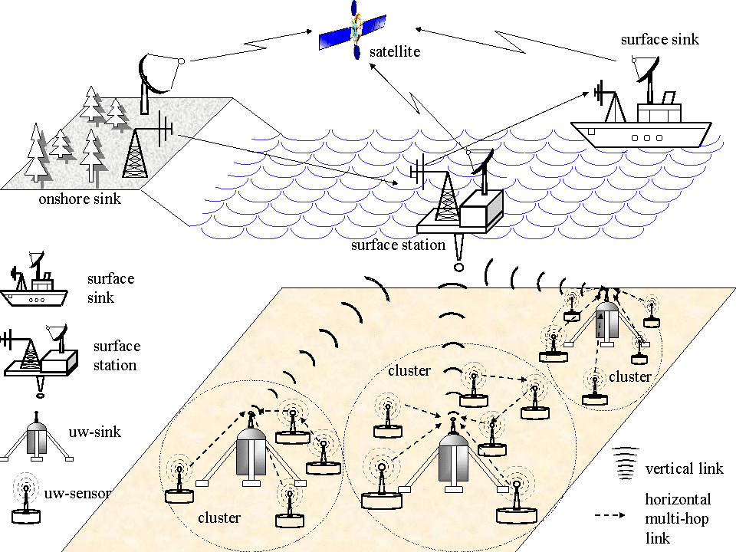
Architecture for 2D underwater sensor networks
(Image Source: http://www.ece.gatech.edu/research/labs/bwn/UWASN/figures/2D_arch.gif )
Presented by Donghyun Kim on September 12, 2008 Mobile Computing and Wireless Networking Research Group at The University of Texas at Dallas

Slide 10
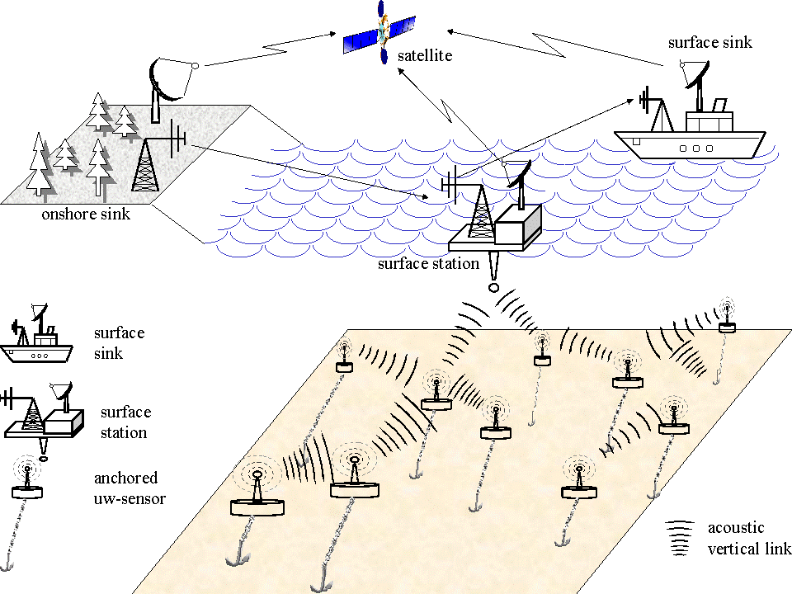
Architecture for 3D underwater sensor networks.
(Image Source: http://www.ece.gatech.edu/research/labs/bwn/UWASN/figures/3D_arch.gif )
Presented by Donghyun Kim on September 12, 2008 Mobile Computing and Wireless Networking Research Group at The University of Texas at Dallas

Slide 11
Sensor networks with Autonomous Underwater Vehicles (AUVs)
In experimental work, inexpensive AUV submarines equipped with multiple underwater sensors can reach any depth in the ocean
AUVs can be used for many purposes
Requires new network coordination algorithms including
Adaptive sampling (Where to AUVs should move?)
Self-configuration (Has to be autonomous)
AUVs can recharge using solar cells
Can survive several months
Presented by Donghyun Kim on September 12, 2008 Mobile Computing and Wireless Networking Research Group at The University of Texas at Dallas

Slide 12
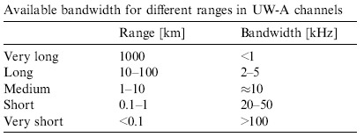
Basics of Acoustic Propagation
Underwater acoustic communications are mainly influenced by
Path loss (by attenuation, geometric spreading)
Noise (man made, ambient noise)
Multi-path (some data is faster, strong function of depth and the distance between transmitter and receiver)
Doppler spread (When receiver is moving, frequency and wavelength can be changed)
High and variable propagation delay
Available bandwidth of the UnderWater Acoustic channel (UW-A) is limited and dramatically dependent on both range and frequency
Presented by Donghyun Kim on September 12, 2008 Mobile Computing and Wireless Networking Research Group at The University of Texas at Dallas

Slide 13
Design Challenges
Differences with terrestrial sensor networks
Cost – expensive (over $1000 vs. TSN $1)
Deployment – (sparse vs. TSN dense)
Communication Power – (higher)
Memory – (caching might be possible)
Spatial correlation (unlikely due to sparseness)
Presented by Donghyun Kim on September 12, 2008 Mobile Computing and Wireless Networking Research Group at The University of Texas at Dallas

Slide 14
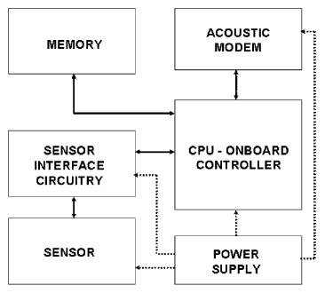
Design Challenges
Underwater Sensors
The electronics are usually mounted on a frame which is protected by a PVC housing (Sometimes whole components are protected by frames)
Challenges
Nano-sensors
Devise periodical cleaning mechanisms against corrosion and fouling
Robust again temperature changes
Synoptic sampling
Presented by Donghyun Kim on September 12, 2008 Mobile Computing and Wireless Networking Research Group at The University of Texas at Dallas

Slide 15
A Cross-Layer Protocol Stack
Conventional layers
Physical layer
Data link layer
Network layer
Transport layer
Application Layer
Application specific layers
Power management plane
Coordination plane
Responsible for all functionalities that require coordination among sensors (i.e. sleep modes, data aggregation, etc.)
Localization plane
Cross-layer design approach
In the conventional layered approach, there has been lacks of information sharing across protocol layers, forcing the network to operate in a suboptimal mode.
Need to use cross-layer design approach to use the scarce recourses better
Modular design approach is preferred
Presented by Donghyun Kim on September 12, 2008 Mobile Computing and Wireless Networking Research Group at The University of Texas at Dallas

Slide 16
USN Network Layer
The network layer is in charge of determining the path between a source and a destination node.
Taxonomy of routing protocols
Proactive protocols (i.e. distance vector based)
Minimize the message latency induced by route discovery
Reactive protocols
Discover a route if necessary (higher latency)
Both of them incur excessive signaling overhead due to their extensive reliance on flooding
Geographical routing protocols
Utilize localization information
Presented by Donghyun Kim on September 12, 2008 Mobile Computing and Wireless Networking Research Group at The University of Texas at Dallas

Slide 17
Research Issues for USN Network Layer
Need to develop algorithms to provide strict or loose latency bounds
Need to develop mechanisms (i.e. routing algorithm) to handle loss of connectivity without provoking immediate retransmissions
Algorithms and protocols need to detect and deal with disconnections due to failures, unforeseen mobility of nodes or battery depletion
Local route optimization algorithms are needed to react to consistent variations in the metrics describing the energy efficiency of the underwater channel
Localization algorithm
Presented by Donghyun Kim on September 12, 2008 Mobile Computing and Wireless Networking Research Group at The University of Texas at Dallas

