Slide 1
Route Recovery in Vertex-Disjoint Multipath Routing for Many-To-One Sensor Networks
Wei Cheng, Kai Xing, Xiuzhen Cheng, Xicheng Lu, Zexin Lu, Jinshu Su, Baosheng Wang, and Yujun Liu, "Route Recovery in Vertex-Disjoint Multipath Routing for Many-To-One Sensor Networks," MOBIHOC 2008, pp. 209-219, Hongkong, China, May 26-30, 2008.
Presented By Donghyun Kim September 19, 2008 Mobile Computing and Wireless Networking Research Group
at University of Texas at Dallas

Slide 2
Motivation
Many-to-one sensor network with unstable links
Presented by Donghyun Kim on September 19, 2008 Mobile Computing and Wireless Networking Research Group at The University of Texas at Dallas

Slide 3
Definitions
Definition 3.1
Given a source node (S) and a destination node (T), a paired vertex-disjoint path set is the set of vertex-disjoint paths between these two nodes.
S
T
Presented by Donghyun Kim on September 19, 2008 Mobile Computing and Wireless Networking Research Group at The University of Texas at Dallas

Slide 4
Definitions – cont’
Definition 3.2
An induced path is a path derived from two paired vertex-disjoint path sets, noted as the basic set and the reference set, respectively, with each starting at different source node (S, P) and both ending at the same destination node (T).
S
T
S
T
P
P
basic set
reference set
Presented by Donghyun Kim on September 19, 2008 Mobile Computing and Wireless Networking Research Group at The University of Texas at Dallas

Slide 5
Definitions – cont’
Definition 3.2 – cont’
The induced path starts from the source node of the basic set, partly overlaps one and only one path in the basic set first, then overlaps at most one path in the reference set, and finally ends at the common destination node.
S
T
S
T
S
T
P
P
P
basic set
reference set
induced path
Presented by Donghyun Kim on September 19, 2008 Mobile Computing and Wireless Networking Research Group at The University of Texas at Dallas

Slide 6
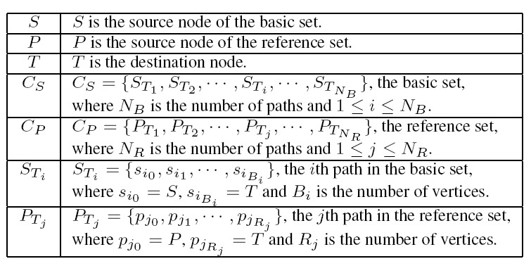
Notations
Presented by Donghyun Kim on September 19, 2008 Mobile Computing and Wireless Networking Research Group at The University of Texas at Dallas

Slide 7
Definitions – cont’
Definition 3.3
is ‘s ordered intersection set, where a node is before in if and only if is closer to than in hop-count.
Presented by Donghyun Kim on September 19, 2008 Mobile Computing and Wireless Networking Research Group at The University of Texas at Dallas

Slide 8
Definitions
Definition 3.4
If a node is the th element of , then ’s subpath from S to this node is called the th level subpath.
Presented by Donghyun Kim on September 19, 2008 Mobile Computing and Wireless Networking Research Group at The University of Texas at Dallas

Slide 9
Definitions
Definition 3.5
A node is ’s effective partition node if and only if it is in both and one of the paths in the basic set, such that ’s subpath from this node to vertex-disjoints all the other paths in the basic set.
(c) Is a effective partition node
Presented by Donghyun Kim on September 19, 2008 Mobile Computing and Wireless Networking Research Group at The University of Texas at Dallas

Slide 10
Definitions
Definition 3.6
‘s subpath from an effective partition node to is called an effective residual path.
Presented by Donghyun Kim on September 19, 2008 Mobile Computing and Wireless Networking Research Group at The University of Texas at Dallas

Slide 11
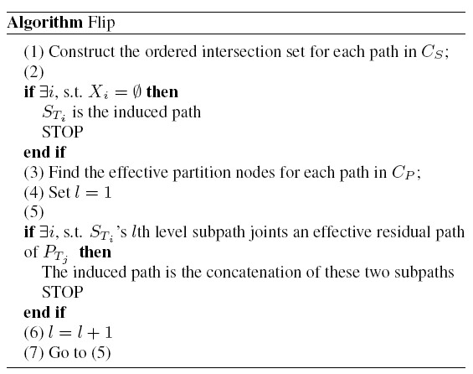
Algorithm Flip
Presented by Donghyun Kim on September 19, 2008 Mobile Computing and Wireless Networking Research Group at The University of Texas at Dallas

Slide 12
Algorithm OMVDP (One More Vertex-Disjoint Path)
Definition 3.7
If a node has N known vertex-disjoint paths to the sink node, it is called a N-credit node.
OMVDP compute N vertex disjoint paths for (N-1)-credit node S given…
There exist a N-credit node P, such that P is not in any of S’s paths and S is not in any of P’s paths, and a path between S and P that vertex-disjoints all the known vertex-disjoint paths from S and P to the sink node T.
Presented by Donghyun Kim on September 19, 2008 Mobile Computing and Wireless Networking Research Group at The University of Texas at Dallas

Slide 13
Additional Notations
Definition 3.7
If a node has N known vertex-disjoint paths to the sink node, it is called a N-credit node.
Presented by Donghyun Kim on September 19, 2008 Mobile Computing and Wireless Networking Research Group at The University of Texas at Dallas

Slide 14
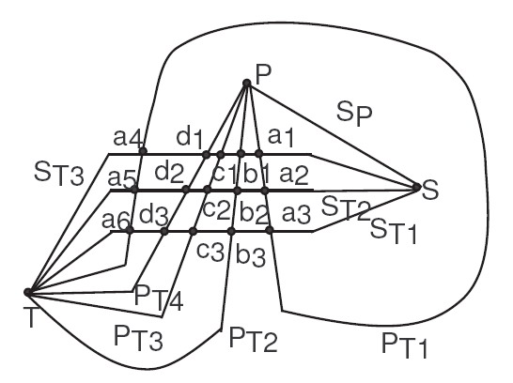
Algorithm OMVDP Example – cont’
Presented by Donghyun Kim on September 19, 2008 Mobile Computing and Wireless Networking Research Group at The University of Texas at Dallas

Slide 15
Algorithm OMVDP Example
Happy Scenario
Presented by Donghyun Kim on September 19, 2008 Mobile Computing and Wireless Networking Research Group at The University of Texas at Dallas

Slide 16
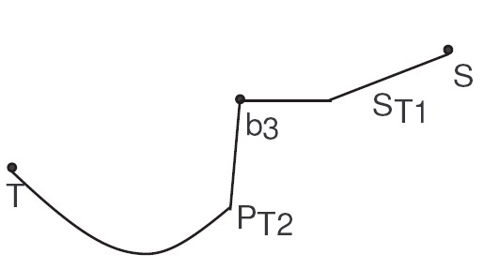
Algorithm OMVDP Example – cont’
Presented by Donghyun Kim on September 19, 2008 Mobile Computing and Wireless Networking Research Group at The University of Texas at Dallas

Slide 17
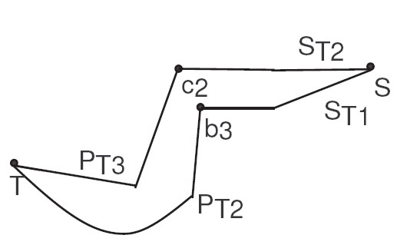
Algorithm OMVDP Example – cont’
Presented by Donghyun Kim on September 19, 2008 Mobile Computing and Wireless Networking Research Group at The University of Texas at Dallas

Slide 18
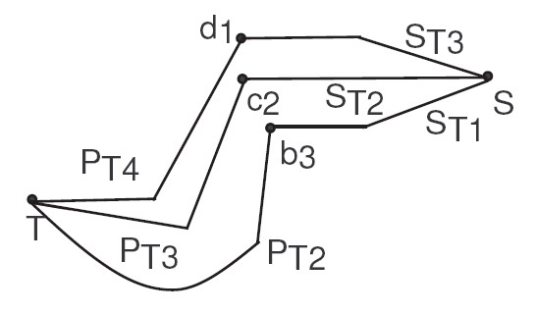
Algorithm OMVDP Example – cont’
Presented by Donghyun Kim on September 19, 2008 Mobile Computing and Wireless Networking Research Group at The University of Texas at Dallas

Slide 19
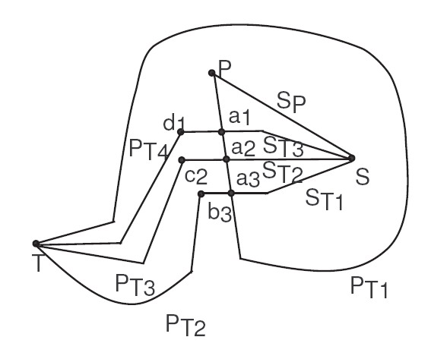
Algorithm OMVDP Example – cont’
Presented by Donghyun Kim on September 19, 2008 Mobile Computing and Wireless Networking Research Group at The University of Texas at Dallas

Slide 20
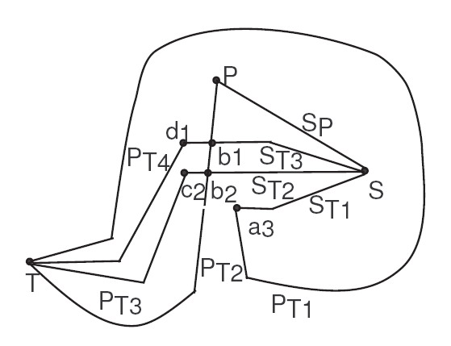
Algorithm OMVDP Example – cont’
Presented by Donghyun Kim on September 19, 2008 Mobile Computing and Wireless Networking Research Group at The University of Texas at Dallas

Slide 21
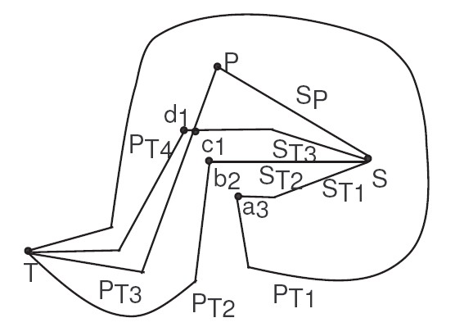
Algorithm OMVDP Example – cont’
Presented by Donghyun Kim on September 19, 2008 Mobile Computing and Wireless Networking Research Group at The University of Texas at Dallas

Slide 22
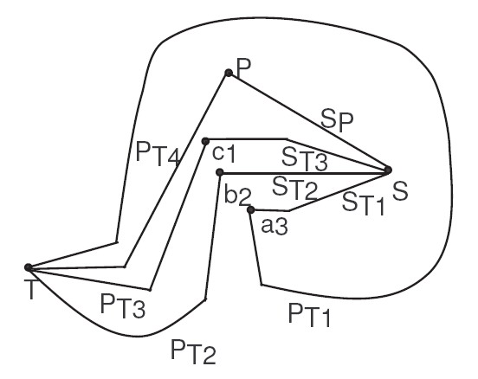
Algorithm OMVDP Example – cont’
Presented by Donghyun Kim on September 19, 2008 Mobile Computing and Wireless Networking Research Group at The University of Texas at Dallas

