Slide 1
Recyclable Connected Dominating Set for Large Scale Dynamic Wireless Networks
Donghyun Kim, Xianyue Li, Feng Zou, Zhao Zhang, and Weili Wu, Recyclable Connected Dominating Set for Large Scale Dynamic Wireless Networks, The 3rd International Conference on Wireless Algorithms, Systems and Applications (WASA 2008), Dallas, TX, Oct. 26-28, 2008.
Presented By Donghyun Kim October 17, 2008 Mobile Computing and Wireless Networking Research Group
at University of Texas at Dallas

Slide 2
Virtual Backbone
In simulation, DSR/AODV over virtual backbones performs better than plain DSR/AODV.
Size does matter!
Communication overhead can be reduced.
Increase the convergence speed (in routing).
Simplify the connectivity management.
Support broadcasting or multicasting.
Reduce the overall energy consumption.
Presented by Donghyun Kim on October 17, 2008 Mobile Computing and Wireless Networking Research Group at The University of Texas at Dallas

Slide 3
Connected Dominating Set
For a graph , a Dominating Set (DS) of is a subset of such that each node in is adjacent to at least one node in . Computing an Maximal Independent Set (MIS) is the most popular way to get DS.
A Connected Dominating Set (CDS) of is a dominating set of which induces a connected subgraph of . Nodes in are called as dominaters. Others are called as dominatees.
Presented by Donghyun Kim on October 17, 2008 Mobile Computing and Wireless Networking Research Group at The University of Texas at Dallas

Slide 4
Connected Dominating Set – cont’
Coloring Technique for MIS computation
Presented by Donghyun Kim on October 17, 2008 Mobile Computing and Wireless Networking Research Group at The University of Texas at Dallas

Slide 5
Motivations
Most CDS computation algorithms assume a static network as an input.
Since wireless networks can be dynamic, we may need to compute CDS very frequently.
Overhead (time, energy consumption) can be more than their benefits.
To reduce the overhead, we recycle the existing CDS, which is broken, to recover a new one.
Presented by Donghyun Kim on October 17, 2008 Mobile Computing and Wireless Networking Research Group at The University of Texas at Dallas

Slide 6
Overview of Our Approach
Compute a CDS using an existing 10.359-approximation algorithm, CDS-BD-1.
When current network is changed, we recover a Dominating Set first and make them to be connected.
The original approximation ratio will be maintained.
Presented by Donghyun Kim on October 17, 2008 Mobile Computing and Wireless Networking Research Group at The University of Texas at Dallas

Slide 7
Algorithm to Handle an Existing Node Deletion
CDS-BD-1
3
2
3
3
2
1
1
2
2
1
0
1
2
3
2
2
3
Presented by Donghyun Kim on October 17, 2008 Mobile Computing and Wireless Networking Research Group at The University of Texas at Dallas

Slide 8
Algorithm to Handle an Existing Node Deletion – cont’
CDS-BD-1
3
2
3
3
2
1
1
2
2
1
0
1
2
3
2
2
3
Presented by Donghyun Kim on October 17, 2008 Mobile Computing and Wireless Networking Research Group at The University of Texas at Dallas

Slide 9
Algorithm to Handle an Existing Node Deletion – cont’
CDS-BD-1
3
2
3
3
2
1
1
2
2
1
0
1
2
3
2
2
3
Presented by Donghyun Kim on October 17, 2008 Mobile Computing and Wireless Networking Research Group at The University of Texas at Dallas

Slide 10
Algorithm to Handle an Existing Node Deletion – cont’
CDS-BD-1
3
2
3
3
2
1
1
2
2
1
0
1
2
3
2
2
3
Presented by Donghyun Kim on October 17, 2008 Mobile Computing and Wireless Networking Research Group at The University of Texas at Dallas

Slide 11
Notations
A UDG represents a wireless network.
When a node is added or deleted, becomes .
is a Maximal Independent Set of .
is a CDS of .
.
A node in is called useless if
it is not used to connect MIS nodes, or
is still connected without it.
Otherwise, the node is called useful.
Presented by Donghyun Kim on October 17, 2008 Mobile Computing and Wireless Networking Research Group at The University of Texas at Dallas

Slide 12
Basic Results
Lemma 1
Suppose we have and every node in is useful. Then, is always true.
Lemma 2.
Suppose a CDS is partitioned by deleting a node. Then, the distance between two nearest partition is at most three hops.
Lemma 3.
Suppose a CDS is partitioned by deleting a node. Then, the CDS is divided into at most five parts.
Presented by Donghyun Kim on October 17, 2008 Mobile Computing and Wireless Networking Research Group at The University of Texas at Dallas

Slide 13
Algorithm to Handle a New Node Insertion
Suppose a new node is added to . Then, we compute as follows.
Case 1 - none of ’s neighbors is in
Case 2 – at least one of ’s neighbors is in
Presented by Donghyun Kim on October 17, 2008 Mobile Computing and Wireless Networking Research Group at The University of Texas at Dallas

Slide 14
Algorithm to Handle a New Node Insertion – cont’
Case 1 - none of ’s neighbors is in
set .
Select one of ’s neighbor and set .
Theorem 1
In Case 1, is an MIS. is a CDS and .
Presented by Donghyun Kim on October 17, 2008 Mobile Computing and Wireless Networking Research Group at The University of Texas at Dallas

Slide 15
Algorithm to Handle a New Node Insertion – cont’
Case 2 – at least one of ’s neighbors is in .
If none of ’s neighbors is in , set .
Theorem 2
In Case 2, is an MIS. is a CDS and .
Presented by Donghyun Kim on October 17, 2008 Mobile Computing and Wireless Networking Research Group at The University of Texas at Dallas

Slide 16
Algorithm to Handle an Existing Node Deletion – Overall Strategy
Recover
Recognize the number of CDS partitions and nodes included in each partition
Remove useless nodes in each partition
If we have more than one CDS partition, add more node (at most 10) to , so that becomes a CDS.
Presented by Donghyun Kim on October 17, 2008 Mobile Computing and Wireless Networking Research Group at The University of Texas at Dallas

Slide 17
Algorithm to Handle an Existing Node Deletion – Overall Strategy
MIS, , reconstruction phase
Suppose is deleted.
If , set and
Suppose is the set of ’s neighbors.
For each ,
if y is not adjacent to any node in , then make .
If , set and .
Theorem 3
After the MIS reconstruction phase, is an MIS of .
Presented by Donghyun Kim on October 17, 2008 Mobile Computing and Wireless Networking Research Group at The University of Texas at Dallas

Slide 18
Algorithm to Handle an Existing Node Deletion
MIS reconstruction phase
y
y
y
x
y
Presented by Donghyun Kim on October 17, 2008 Mobile Computing and Wireless Networking Research Group at The University of Texas at Dallas

Slide 19
Algorithm to Handle an Existing Node Deletion – Sweeper Algorithm
MIS reconstruction phase
y
y
y
y
Presented by Donghyun Kim on October 17, 2008 Mobile Computing and Wireless Networking Research Group at The University of Texas at Dallas

Slide 20
Algorithm to Handle an Existing Node Deletion – Overall Strategy
Seeper Algorithm
Tree Traversal Algorithm
Goals
Recognize each CDS partition
Remove useless CDS node in each partition
Theorem 4
After Sweeper is executed, every CDS in each partition is useful and any two CDS nodes have same color iff they are in the same partition.
Presented by Donghyun Kim on October 17, 2008 Mobile Computing and Wireless Networking Research Group at The University of Texas at Dallas

Slide 21
Algorithm to Handle an Existing Node Deletion – Sweeper Algorithm
Sweeper
Presented by Donghyun Kim on October 17, 2008 Mobile Computing and Wireless Networking Research Group at The University of Texas at Dallas

Slide 22
Algorithm to Handle an Existing Node Deletion – Sweeper Algorithm
Sweeper
1
1
1
Presented by Donghyun Kim on October 17, 2008 Mobile Computing and Wireless Networking Research Group at The University of Texas at Dallas

Slide 23
Algorithm to Handle an Existing Node Deletion – Sweeper Algorithm
Sweeper
2
1
1
1
Presented by Donghyun Kim on October 17, 2008 Mobile Computing and Wireless Networking Research Group at The University of Texas at Dallas

Slide 24
Algorithm to Handle an Existing Node Deletion – Sweeper Algorithm
Sweeper
2
3
1
3
3
1
1
3
3
3
Presented by Donghyun Kim on October 17, 2008 Mobile Computing and Wireless Networking Research Group at The University of Texas at Dallas

Slide 25
Algorithm to Handle an Existing Node Deletion – Overall Strategy
Reconnection Algorithm
By Lemma 3, we have at most 5 partitions and we need at most 8 nodes to connect them.
Theorem 5
After RCDSA reconnects a broken CDS and suppose is a resulting CDS. Then, is still true.
Presented by Donghyun Kim on October 17, 2008 Mobile Computing and Wireless Networking Research Group at The University of Texas at Dallas

Slide 26
Algorithm to Handle an Existing Node Deletion – Sweeper Algorithm
Reconnection Algorithm
2
3
1
3
3
1
1
3
3
3
Presented by Donghyun Kim on October 17, 2008 Mobile Computing and Wireless Networking Research Group at The University of Texas at Dallas

Slide 27
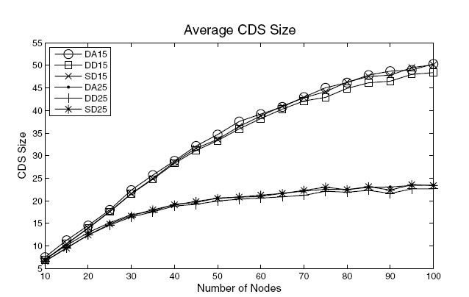
Simulation Results
Presented by Donghyun Kim on October 17, 2008 Mobile Computing and Wireless Networking Research Group at The University of Texas at Dallas

Slide 28
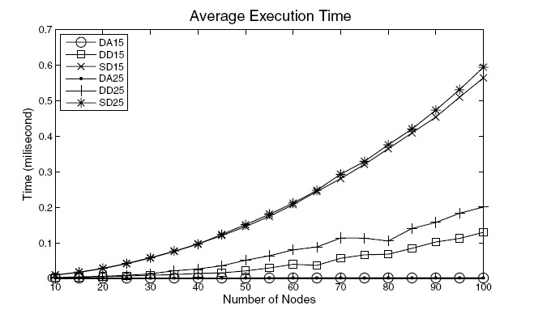
Simulation Results – cont’
Presented by Donghyun Kim on October 17, 2008 Mobile Computing and Wireless Networking Research Group at The University of Texas at Dallas

Slide 29
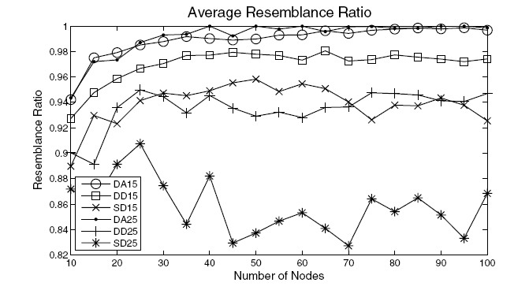
Simulation Results – cont’
Presented by Donghyun Kim on October 17, 2008 Mobile Computing and Wireless Networking Research Group at The University of Texas at Dallas

