Slide 1
Distributed Minimum-Cost Clustering for Underwater Sensor Networks
Pu Wang, Cheng Li, Jun Zheng, Distributed Minimum-Cost Clustering Protocol for UnderWater Sensor Networks (UWSNs), IEEE International Conference on Communications (ICC '07), pp. 3510-3515, June 24-28, 2007.
Presented By Donghyun Kim January 15, 2009 Mobile Computing and Wireless Networking Research Group
at University of Texas at Dallas

Slide 2
Target Underwater Sensor Network (USN) Structure
A (normally 2D, static) USN normally consists of
Underwater sensor nodes
One or more UnderWater Sinks (UW-Sinks)
One or more out-of-water sinks (Out-of-water sink or station)
On-shore station
Presented by Donghyun Kim on January 15, 2009 Mobile Computing and Wireless Networking Research Group at The University of Texas at Dallas

Slide 3
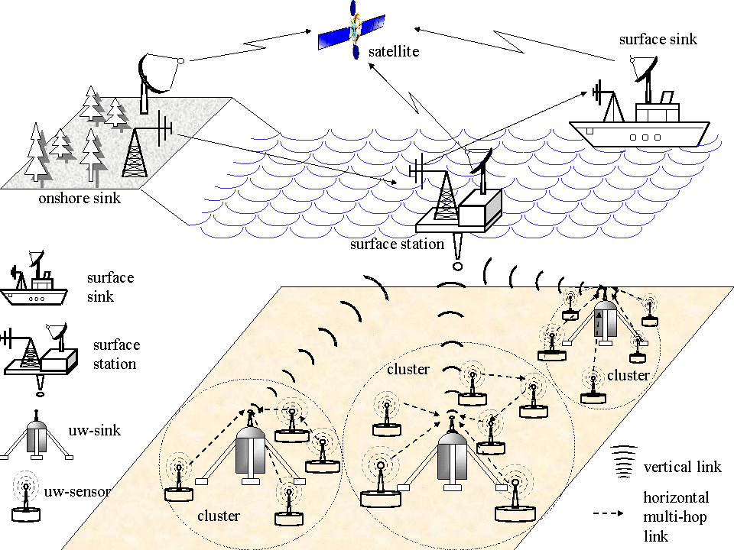
Architecture for 2D USNs
(Image Source: http://www.ece.gatech.edu/research/labs/bwn/UWASN/figures/2D_arch.gif )
Presented by Donghyun Kim on January 15, 2009 Mobile Computing and Wireless Networking Research Group at The University of Texas at Dallas

Slide 4
Special Requirements for Minimum Cost Clustering in USNs
Every node is a cluster head candidate (like 1-tier clustering)
Three cost metrics
The total energy consumption of the cluster members for sending data to the cluster head
The residual energy of the cluster head and its cluster members
The relative location between the cluster head and the UW-Sink (2-tier clustering?)
Presented by Donghyun Kim on January 15, 2009 Mobile Computing and Wireless Networking Research Group at The University of Texas at Dallas

Slide 5
Network Model and Assumptions
Homogeneous ocean bottom sensor nodes
Each node can adjust its transmission range with transmission power control
A UW-Sink is connecting sensor nodes to a out-of-water sink (an on-shore control center)
This paper assumes only one fixed UW-Sink
Presented by Donghyun Kim on January 15, 2009 Mobile Computing and Wireless Networking Research Group at The University of Texas at Dallas

Slide 6
Notations
is the set of sensor nodes in a given USN.
is the set of node within ’s cluster diameter (1-hop neighbors)
is the cardinality of ’s
is the powerset of
can form a potential cluster (1-hop)
There can be potential clusters.
is the cluster set which consists of all the potential clusters in the network
Presented by Donghyun Kim on January 15, 2009 Mobile Computing and Wireless Networking Research Group at The University of Texas at Dallas

Slide 7
Minimum-Cost Node Clustering (MCNC) Problem
A Cluster-Centric Cost-based Formulation
Objective:
Improve the energy efficiency and prolong the lifetime of the network
Select a set of potential clusters to cover the whole network so that the overall cost of all selected clusters is minimized, i.e. where and .
Presented by Donghyun Kim on January 15, 2009 Mobile Computing and Wireless Networking Research Group at The University of Texas at Dallas

Slide 8
Cost Metric
Cluster cost (cost for a potential cluster)
The total energy consumption of the cluster members for sending data to the cluster head
The relative location between the cluster head and the (nearest) UW-Sink
The residual energy of the cluster head and its cluster members
Presented by Donghyun Kim on January 15, 2009 Mobile Computing and Wireless Networking Research Group at The University of Texas at Dallas

Slide 9
Cost Metric – cont’
Given a potential cluster ,where is a clusterhead candidate and is a cluster member set of , the cluster cost of cluster is defined as where is the total energy consumed by all sensor nodes in for sending one data packet to (also called intra-cluster cost). is the energy consumed by for sending one data packet to the uw-sink directly (Euc. distance / data aggregator).
Presented by Donghyun Kim on January 15, 2009 Mobile Computing and Wireless Networking Research Group at The University of Texas at Dallas

Slide 10
Cost Metric – cont’
To more comprehensively reflect the dynamic energy status of the cluster, the residual energy of the cluster head and its cluster members should also be considered
Idea
Initially, the cost function is dominated by energy consumption
When the residual energy of the clusterhead candidate becomes small, the residual energy tem dominates the cost function
Presented by Donghyun Kim on January 15, 2009 Mobile Computing and Wireless Networking Research Group at The University of Texas at Dallas

Slide 11
Cost Metric – cont’
Final cost function
where (or ) is the residual energy of node (or ) normalized by the initial energy of the node and
Presented by Donghyun Kim on January 15, 2009 Mobile Computing and Wireless Networking Research Group at The University of Texas at Dallas

Slide 12
Distributed Minimum-Cost Clustering Algorithm (MCCA)
MCNC is very similar to the Minimum Weight Set Cover (MWSC) problem
In MWSC, a point can be covered multiple times, while in MCNC, it has to be covered by only one cluster
Chvatal’s Algorithm for MWSC (in 1979)
Presented by Donghyun Kim on January 15, 2009 Mobile Computing and Wireless Networking Research Group at The University of Texas at Dallas

Slide 13
Distributed Minimum-Cost Clustering Algorithm (MCCA) – cont’
Proposed Algorithm
Presented by Donghyun Kim on January 15, 2009 Mobile Computing and Wireless Networking Research Group at The University of Texas at Dallas

