Slide 1
A Distributed Clustering Scheme For Underwater Sensor Networks
M.C. Domingo and R. Prior, A Distributed Clustering Scheme For Underwater Wireless Sensor Networks, the 18th IEEE International Symposium on Personal Indoor and Mobile Radio Communications (PIMRC 2007), Sept. 3-7, 2007.
Presented By Donghyun Kim January 22, 2009 Mobile Computing and Wireless Networking Research Group
at University of Texas at Dallas

Slide 2
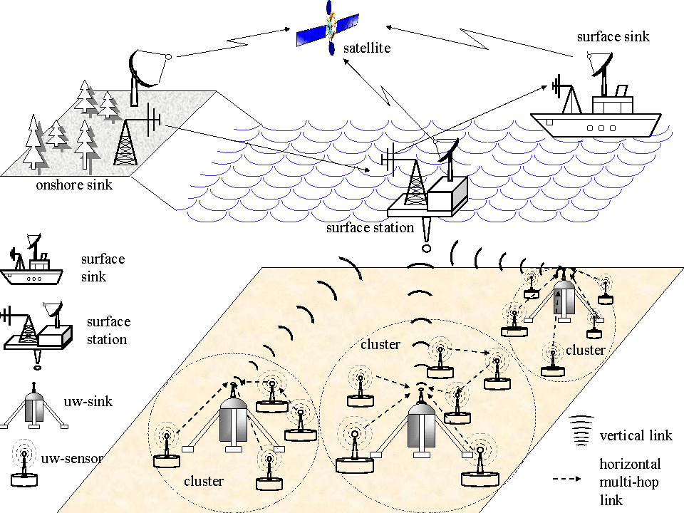
Architecture for 2D USNs
Presented by Donghyun Kim on January 22, 2009 Mobile Computing and Wireless Networking Research Group at The University of Texas at Dallas

Slide 3
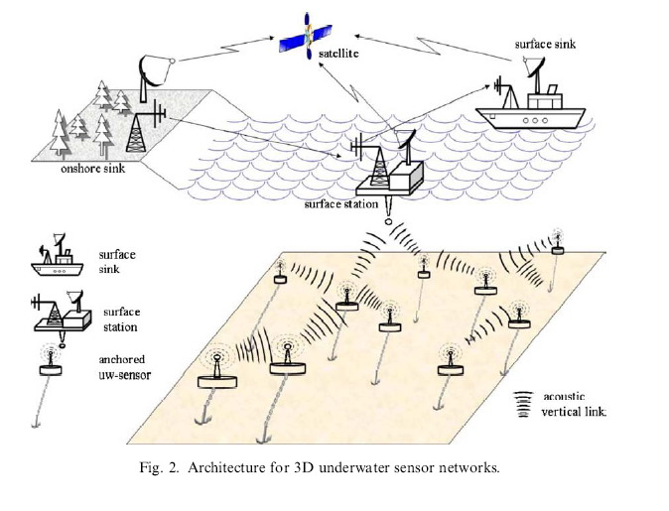
Architecture for 3D USNs
Presented by Donghyun Kim on January 22, 2009 Mobile Computing and Wireless Networking Research Group at The University of Texas at Dallas

Slide 4
Underwater Sensor Networks (USNs)
Has to support
Scalability
Mobility
Self-organization
Energy-efficiency
Challenges
Large propagation delay
Node mobility
High error probability of acoustic underwater channels (especially for a long range communication)
Etc. (a lot)
It is important to design a robust, scalable, and energy-efficient routing protocol (it is a multi-hop network).
Presented by Donghyun Kim on January 22, 2009 Mobile Computing and Wireless Networking Research Group at The University of Texas at Dallas

Slide 5
Searching for the Best Routing Scheme for USNs
Proactive ad-hoc routing protocols
Exchange message continuously
Reactive ad-hoc routing protocols
Use flooding-based technique for a route discovery
This paper present a Distributed Underwater Clustering Scheme (DUCS)
A new distributed energy-aware routing protocol designed for long-term non-time-critical aquatic monitoring applications
GPS-free routing protocol for UWSNs which does not use flooding techniques
Minimize the proactive routing message exchange
Use data aggregation to eliminate redundant information
Consider random node mobility and compensate the high propagation delays of the underwater medium
Presented by Donghyun Kim on January 22, 2009 Mobile Computing and Wireless Networking Research Group at The University of Texas at Dallas

Slide 6
Assumptions
Underwater sensor nodes always have data to be sent to the sink
The nodes can use power control to adjust its transmission power
Node are time synchronized (did not mentioned explicitly in the paper)
Presented by Donghyun Kim on January 22, 2009 Mobile Computing and Wireless Networking Research Group at The University of Texas at Dallas

Slide 7
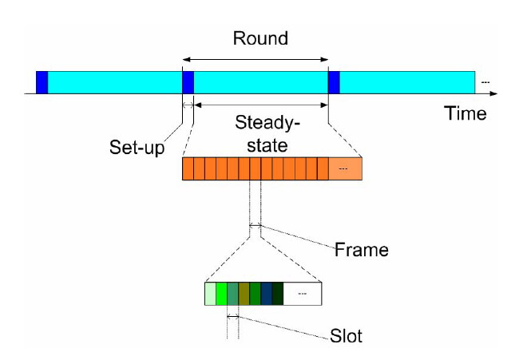
DUCS Protocol
Construct a single hop clustered network
Clusterheads are rotated randomly to avoid the energy exhaustion of one node
Presented by Donghyun Kim on January 22, 2009 Mobile Computing and Wireless Networking Research Group at The University of Texas at Dallas

Slide 8
DUCS Protocol – cont’
Clusterhead selection algorithm
Each non-clusterhead decides to which cluster it belongs by choosing the clusterhead that requires the minimum communication energy and consequently its power level required for transmission (proportional to distance which can be found using ToA (Time-of-Arrival) method) is minimized.
Presented by Donghyun Kim on January 22, 2009 Mobile Computing and Wireless Networking Research Group at The University of Texas at Dallas

Slide 9
DUCS Protocol – cont’
Cluster Formation Algorithm and Network Operation Phase
A clusterhead communicates with its members using CDMA
Use TDMA as a MAC to allow non-clusterhead node can sleep for some time
How to prevent collision on the clusterhead caused by the long propagation delay?
Each node transmits in advance relatively to its reception by a time compensating the propagation delay (timing advance – computed by a clusterhead)
Presented by Donghyun Kim on January 22, 2009 Mobile Computing and Wireless Networking Research Group at The University of Texas at Dallas

Slide 10
DUCS Protocol – cont’
Some notations
A set of nodes in a cluster:
A clusterhead:
Propagation delay from a node to its clusterhead:
Current round:
First node transmits a message at
Second node transmits a message at
In general, node
In (t+1) round
Presented by Donghyun Kim on January 22, 2009 Mobile Computing and Wireless Networking Research Group at The University of Texas at Dallas

Slide 11
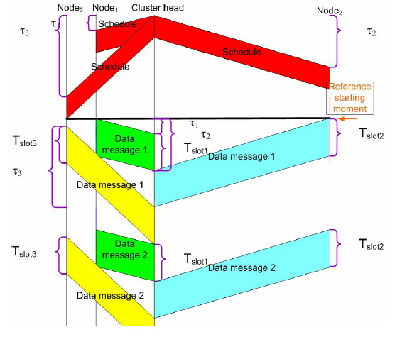
DUCS Protocol – cont’
Presented by Donghyun Kim on January 22, 2009 Mobile Computing and Wireless Networking Research Group at The University of Texas at Dallas

Slide 12
DUCS Protocol – cont’
So far, we assume that are invariant
Use one tenth of a time slot as a guard time (do not use)
Cluster maintenance
In each time slot reserved for maintenance, each node estimate its propagation delay
If this delay changed more than 50%, it chooses another clusterhead (what happens if CH is gone?)
Message Routing
Shortest path routing…
Presented by Donghyun Kim on January 22, 2009 Mobile Computing and Wireless Networking Research Group at The University of Texas at Dallas

