Slide 1
Multi-Level Hierarchies for Scalable Ad hoc Routing
E.M. Belding-Royer, Multi-level hierarchies for scalable ad hoc routing, Wireless Networks, Volume 9 , Issue 5, pp.461-478, September 2003.
Presented By Donghyun Kim January 29, 2009 Mobile Computing and Wireless Networking Research Group
at University of Texas at Dallas

Slide 2
Introduction to Wireless Network Clustering
See old my presentation file at
http://theory.utdallas.edu/Donghyun_Kim/Seminar1_Fall2008/dhk20080905.pptx
Presented by Donghyun Kim on January 29, 2009 Mobile Computing and Wireless Networking Research Group at The University of Texas at Dallas

Slide 3
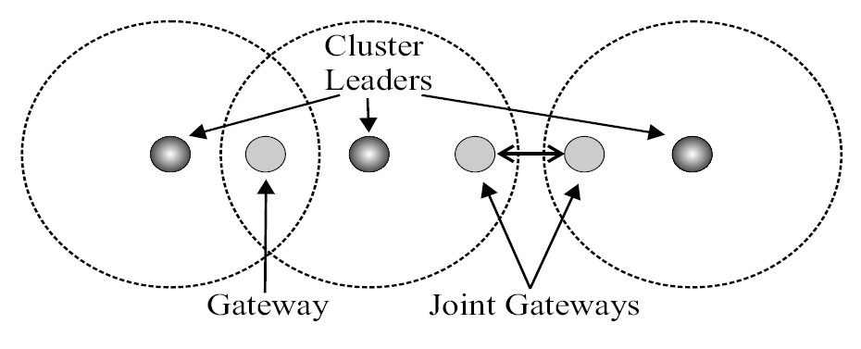
One-Level Hierarchical Clusters -Adaptive Routing using Clusters (ARC) Protocol
ARC groups nodes into clusters based on the nodes’ (geographical) proximity to one another.
One-hop clustering protocol
Terms
Cluster leader (cluster head) – cldr
Gateway node – gateway
Joint gateway nodes
Ordinary node - node
Presented by Donghyun Kim on January 29, 2009 Mobile Computing and Wireless Networking Research Group at The University of Texas at Dallas

Slide 4
Adaptive Routing using Clusters (ARC) Protocol
Initialization
Periodically, a non-leader node sends a Hello message including its cluster leaders’ IP.
Hello messages serve the purpose of announcing the presence of nodes and their current status level, as well as indicating connectivity information of the non-leader nodes.
The TTL of Hello messages is 1 – never retransmitted.
After a node sends a Hello message, it starts timer. During this time, the node records the IP address of any cluster leaders from which it receives a Hello message.
(cldr)
(Gateway)
Hello
Hello
(Undefined)
Presented by Donghyun Kim on January 29, 2009 Mobile Computing and Wireless Networking Research Group at The University of Texas at Dallas

Slide 5
Adaptive Routing using Clusters (ARC) Protocol – cont’
Discovering the topology
Case 1: no adjacent cluster leader
Becomes a cluster leader
Case 2: have only one adjacent cluster leader
Becomes an ordinary node
Case 3: have more than one adjacent cluster leader
Becomes a gateway node
Case 4(5): have only one adjacent cluster leader and at least one adjacent gateway node (or an ordinary node adjacent to another leader node)
Becomes a (joint)gateway node
Presented by Donghyun Kim on January 29, 2009 Mobile Computing and Wireless Networking Research Group at The University of Texas at Dallas

Slide 6
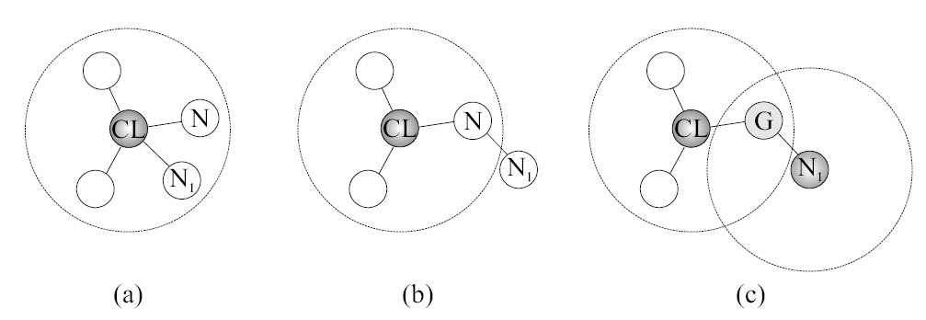
Adaptive Routing using Clusters (ARC) Protocol – cont’
Status changes
Ordinary to gateway
Gateway to ordinary
Ordinary to cluster leader
Presented by Donghyun Kim on January 29, 2009 Mobile Computing and Wireless Networking Research Group at The University of Texas at Dallas

Slide 7
Adaptive Routing using Clusters (ARC) Protocol – cont’
Become an ordinary node (Cluster merge)
More cluster leaders => less efficient
Trivial solution: when two cluster leaders come within direct transmission range of one another, one leader must give up its leader status => cause a rippling effect.
Presented by Donghyun Kim on January 29, 2009 Mobile Computing and Wireless Networking Research Group at The University of Texas at Dallas

Slide 8
Adaptive Routing using Clusters (ARC) Protocol – cont’
Cluster leader changes are expensive due to the changes in routing paths which occur as result.
How to avoid the rippling effect? => enforce the “subset property”.
Presented by Donghyun Kim on January 29, 2009 Mobile Computing and Wireless Networking Research Group at The University of Texas at Dallas

Slide 9
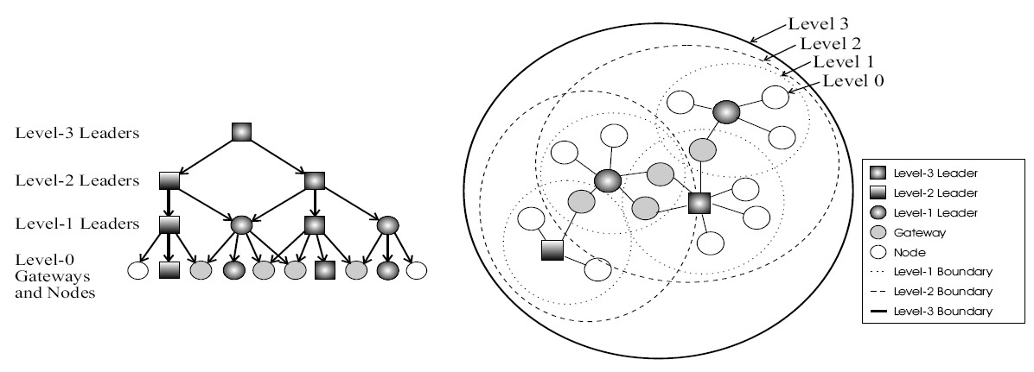
Multi-Level Hierarchical Clusters -Adaptive Routing using Cluster Hierarchies (ARCH) Protocol
A one-level clustering system increases scalability and robustness of routs, but its benefit is limited when networks grow to thousands or tens of thousands of nodes.
Presented by Donghyun Kim on January 29, 2009 Mobile Computing and Wireless Networking Research Group at The University of Texas at Dallas

Slide 10
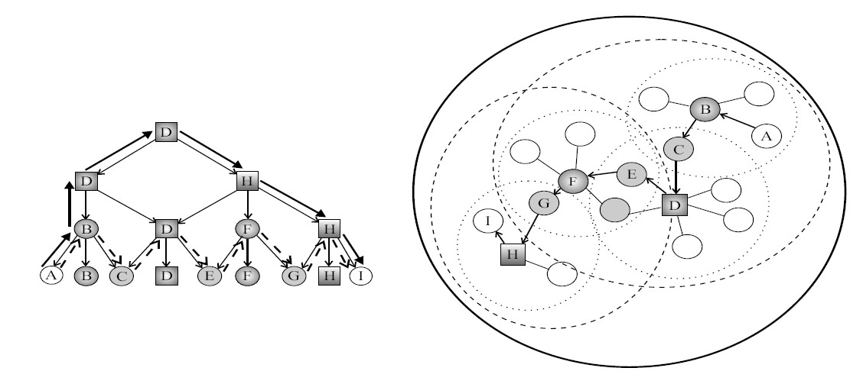
Multi-Level Hierarchical Clusters -Adaptive Routing using Cluster Hierarchies (ARCH) Protocol
Benefit of multi-layer clustering
Route path without clustering
A-B-C-D-E-F-G-H-I (Precise (shortest path) routing but bigger routing table)
Route path with clustering
A-B-D-H-I
Presented by Donghyun Kim on January 29, 2009 Mobile Computing and Wireless Networking Research Group at The University of Texas at Dallas

Slide 11
Adaptive Routing using Cluster Hierarchies (ARCH) Protocol
Each node maintains (status, status level) pair.
Ordinary node: (node, undef)
Gateway node: (gateway, undef)
Level-m leader node: (cldr, m)
Presented by Donghyun Kim on January 29, 2009 Mobile Computing and Wireless Networking Research Group at The University of Texas at Dallas

Slide 12
Adaptive Routing using Cluster Hierarchies (ARCH) Protocol – cont’
Hierarchy initialization and discovery
A leader at status level- is also a level- cluster leader for all .
At each level, the distance between any two cluster leader can be at most 3 hops – assume this as 1 unit (cluster) hop.
(cldr)
(Gateway)
Hello
Hello (
associated cluster leader list = {(leader IP, level),…},
associated upper level leader’s hierarchy structure = {(leader IP, level, hop distance),…}
)
(Undefined)
Presented by Donghyun Kim on January 29, 2009 Mobile Computing and Wireless Networking Research Group at The University of Texas at Dallas

Slide 13
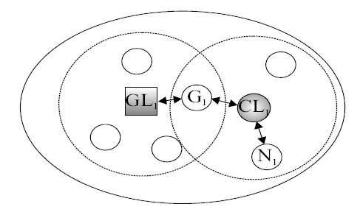
Adaptive Routing using Cluster Hierarchies (ARCH) Protocol – cont’
Topology discovery example.
= level 2 cluster leader
= level 1 cluster leader
Presented by Donghyun Kim on January 29, 2009 Mobile Computing and Wireless Networking Research Group at The University of Texas at Dallas

Slide 14
Adaptive Routing using Cluster Hierarchies (ARCH) Protocol – cont’
Building and maintaining the hierarchy
0
0
1
0
0
1
0
0
1
0
1
0
Presented by Donghyun Kim on January 29, 2009 Mobile Computing and Wireless Networking Research Group at The University of Texas at Dallas

Slide 15
Adaptive Routing using Cluster Hierarchies (ARCH) Protocol – cont’
Building and maintaining the hierarchy
0
0
1
0
0
2
0
0
1
0
2
0
Presented by Donghyun Kim on January 29, 2009 Mobile Computing and Wireless Networking Research Group at The University of Texas at Dallas

Slide 16
Adaptive Routing using Cluster Hierarchies (ARCH) Protocol – cont’
Building and maintaining the hierarchy
0
0
1
0
0
3
0
0
1
0
2
0
Presented by Donghyun Kim on January 29, 2009 Mobile Computing and Wireless Networking Research Group at The University of Texas at Dallas

Slide 17
Adaptive Routing using Cluster Hierarchies (ARCH) Protocol – cont’
In general, each leader examines the hierarchical information contained in the hierarchy list of the Hello message.
Each of the following conditions must hold true for a leader to increment its level.
The leader does not already have a hierarchical parent.
The leader is the same status level as another leader in either the hierarchy list or the cluster leader list.
The leader’s IP address (which is used to break ties) is greater than that of the other leader with the same status level.
A leader decrements its status level in one of two situation.
When its cluster becomes a subset of another cluster.
When it determines that it no longer needs to be at as high a level.
1
2
1
2
1
2
3
2
2
1
2
?
?
?
?
3
2
?
?
Presented by Donghyun Kim on January 29, 2009 Mobile Computing and Wireless Networking Research Group at The University of Texas at Dallas

Slide 18
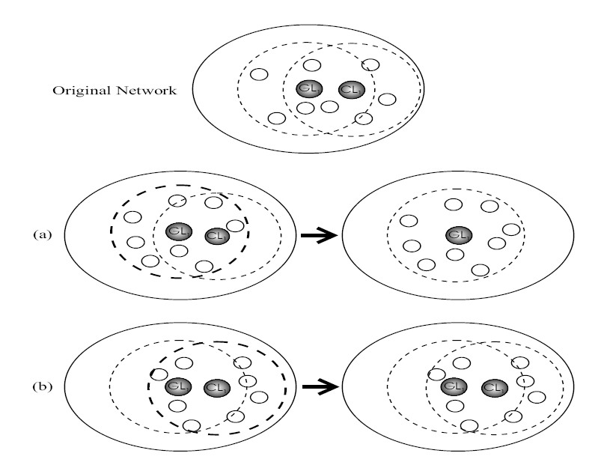
Adaptive Routing using Cluster Hierarchies (ARCH) Protocol – cont’
When two leaders come within direct transmission range of each other, it is possible that one of them will give up its leader status.
Presented by Donghyun Kim on January 29, 2009 Mobile Computing and Wireless Networking Research Group at The University of Texas at Dallas

Slide 19
Conclusion and Future Work
Presented by Donghyun Kim on January 29, 2009 Mobile Computing and Wireless Networking Research Group at The University of Texas at Dallas

