Slide 1
A Better Approximation for Minimum Total Routing Path Clustering Problem in 2-D Underwater Sensor Networks
Wei Wang, Donghyun Kim, and Weili Wu, A Better Approximation for Minimum Total
Routing Path Clustering Problem in 2-D Underwater Sensor Networks.
Presented By Donghyun Kim March 5, 2009 Mobile Computing and Wireless Networking Research Group
at University of Texas at Dallas

Slide 2
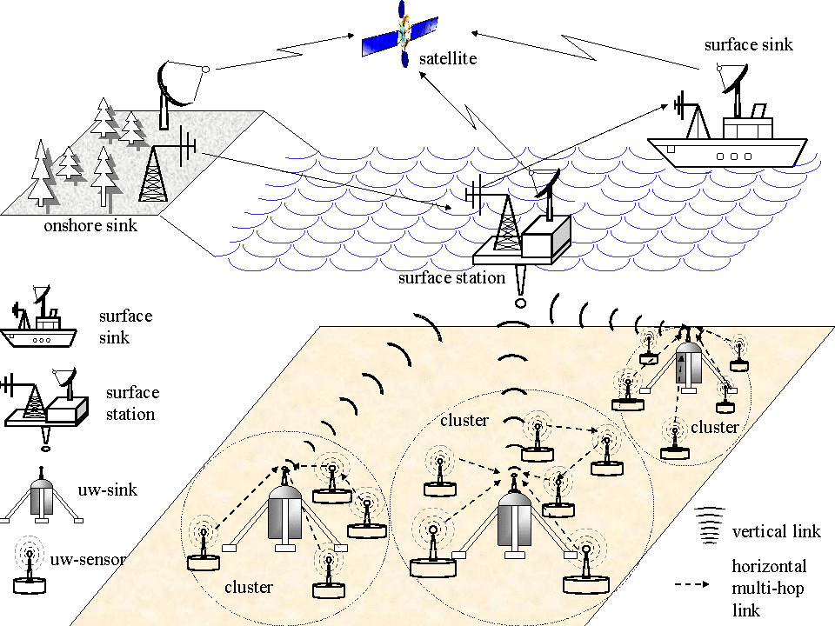
Architecture for 2-D Underwater Sensor Networks
(Image Source: http://www.ece.gatech.edu/research/labs/bwn/UWASN/figures/2D_arch.gif )
Presented by Donghyun Kim on March 5, 2009 Mobile Computing and Wireless Networking Research Group at The University of Texas at Dallas

Slide 3
Characteristic of USNs
A USN consists of both static and mobile sensor nodes.
Energy is a still scarce resource.
Energy consumption of underwater communication increases exponentially proportional to the transmission range.
Multi-hop transmission is preferred over directed one.
Presented by Donghyun Kim on March 5, 2009 Mobile Computing and Wireless Networking Research Group at The University of Texas at Dallas

Slide 4
Clustering in USNs
UW-Sinks
Normal Nodes
Presented by Donghyun Kim on March 5, 2009 Mobile Computing and Wireless Networking Research Group at The University of Texas at Dallas

Slide 5
Clustering in USNs – cont’
UW-Sinks
Normal Nodes
Clusterheads
Presented by Donghyun Kim on March 5, 2009 Mobile Computing and Wireless Networking Research Group at The University of Texas at Dallas

Slide 6
Data Fusion in Clustered USNs
It is around
10-12
Normal Nodes
Clusterheads
Presented by Donghyun Kim on March 5, 2009 Mobile Computing and Wireless Networking Research Group at The University of Texas at Dallas

Slide 7
Benefits of Clustering in USNs
Ensure basic level system performance, such as throughput and delay.
Make USNs more energy efficient by reducing collision.
Each clusterhead can be sued as a local data fusion point.
Merging data from the same cluster will not decrease the accuracy of information.
Multi-level merging may reduce precision.
Presented by Donghyun Kim on March 5, 2009 Mobile Computing and Wireless Networking Research Group at The University of Texas at Dallas

Slide 8
Communication in Clustered USNs
1. Direct Communication Model
UW-Sinks
Normal Nodes
Clusterheads
Presented by Donghyun Kim on March 5, 2009 Mobile Computing and Wireless Networking Research Group at The University of Texas at Dallas

Slide 9
Communication in Clustered USNs – cont’
2. Multi-hop: shortest path
UW-Sinks
Normal Nodes
Clusterheads
Presented by Donghyun Kim on March 5, 2009 Mobile Computing and Wireless Networking Research Group at The University of Texas at Dallas

Slide 10
Communication in Clustered USNs – cont’
3. Multi-hop: Clustering-based Routing
UW-Sinks
Normal Nodes
Clusterheads
Presented by Donghyun Kim on March 5, 2009 Mobile Computing and Wireless Networking Research Group at The University of Texas at Dallas

Slide 11
Assumptions
Assumptions
Every node will use the same maximum transmission range for energy efficiency.
Target USNs require high data accuracy.
Each clusterhead is used as a local data fusion point, but no further aggregation.
Clustering-based shortest path routing is used.
Presented by Donghyun Kim on March 5, 2009 Mobile Computing and Wireless Networking Research Group at The University of Texas at Dallas

Slide 12
Problem Formulation
d
The number of hops in total routing path
s
Presented by Donghyun Kim on March 5, 2009 Mobile Computing and Wireless Networking Research Group at The University of Texas at Dallas

Slide 13
Problem Formulation – cont’
Minimum Total Routing Path Clustering Problem (MTRPCP)
Given a set of sensor nodes and UW-Sinks on the Euclidean plane, MTRPCP is find a set of clusterheads such that each sensor node is adjacent to at least one clusterhead, and the total distances from each clusterhead to its nearest UW-Sink is minimized. In other words, we want to minimize
Presented by Donghyun Kim on March 5, 2009 Mobile Computing and Wireless Networking Research Group at The University of Texas at Dallas

Slide 14
A relaxation from MTRPCP to Minimum Weight Dominating Set Problem (MWDSP-R)
3
4
3
1
2
3
1
2
2
1
3
1
1
1
Presented by Donghyun Kim on March 5, 2009 Mobile Computing and Wireless Networking Research Group at The University of Texas at Dallas

Slide 15
Previous Result
Theorem 1
A c-approximation algorithm for MWDSP-R is a 3c -approximation algorithm for MTRPCP.
Existing algorithms for MWDSP.
Slow algorithms (centralized, enumeration)
72-approximation = 216-app. for MTRPCP
-approximation = -app. for MTRPCP
Quick Algorithm (distributed, greedy)
-approximation = -app. For MTRPCP
Presented by Donghyun Kim on March 5, 2009 Mobile Computing and Wireless Networking Research Group at The University of Texas at Dallas

Slide 16
Contribution of This paper
Show MWDSP-R is NP-complete.
Introduce a PTAS for MWDSP-R.
It is a -approximation algorithm for MTRPCP.
Presented by Donghyun Kim on March 5, 2009 Mobile Computing and Wireless Networking Research Group at The University of Texas at Dallas

Slide 17
Definitions
Growth-Bounded Graph
A graph is -growth-bounded if there exists a function such that for all , where only depends on a positive integer and is independent from the structure of graph .
It is known that both UDGs and UBGs are growth-bounded graphs.
2-Deparated Partition
Given a graph G, a collection of subsets of such that is a 2- Separated Partition of , if
Presented by Donghyun Kim on March 5, 2009 Mobile Computing and Wireless Networking Research Group at The University of Texas at Dallas

Slide 18
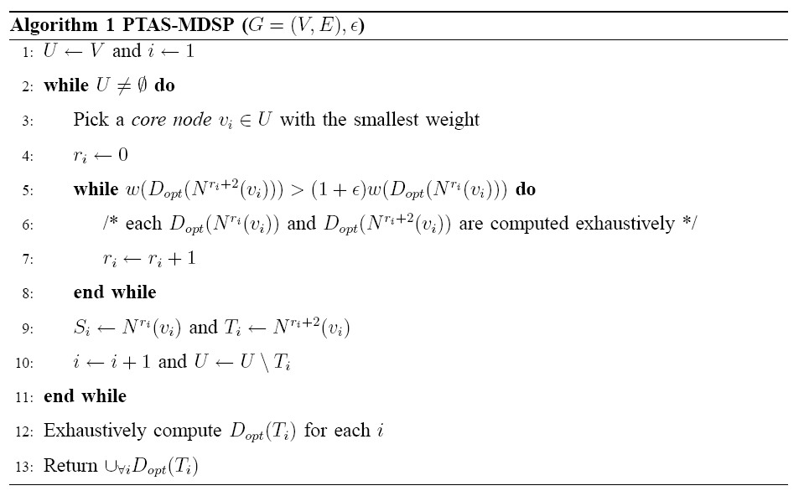
A PTAS for MWDSP-R
Presented by Donghyun Kim on March 5, 2009 Mobile Computing and Wireless Networking Research Group at The University of Texas at Dallas

Slide 19
Things to Prove
For all , there is such that .
Algorithm will terminate eventually.
The result of algorithm is a feasible solution of MWDSP-R, a dominating set.
The running time of this algorithm is polynomial with performance ratio .
MTRPCP is NP-complete <= Ongoing!
MWDSP-R is NP-complete.
Presented by Donghyun Kim on March 5, 2009 Mobile Computing and Wireless Networking Research Group at The University of Texas at Dallas

